Slide 1


Lomuto Partitioning Algorithm
Name: Ahmed Ayman Mohamed
Id:221341

Slide 2

Introduction to Lomuto Partitioning Algorithm
The Lomuto partitioning algorithm is an in-place algorithm used for sorting an array by dividing it into two partitions based on a pivot element.
By understanding the intricacies of this algorithm, we can optimize our sorting process and improve the efficiency of our programs.

Slide 3

Explanation of the Lomuto Partitioning Process
1
Select Pivot
Choose a pivot element, like the first element in the array, to compare with the rest of the elements.
2
Partitioning
Iterate through the array, placing elements smaller than the pivot on the left side and larger elements on the right side.

Slide 4
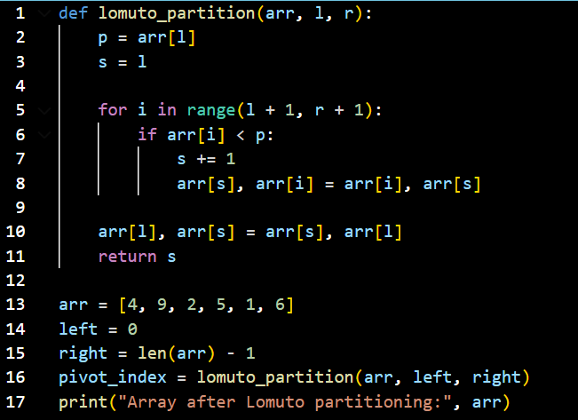
Implementation of Lomuto Partitioning Algorithm

Slide 5


Time Complexity and Space Complexity Analysis
Time Complexity
$$\sum_{i=1}^{n}{1}$$
$$=n−1+1$$
$$=n$$
$$O ε (n)$$

Slide 6

Thank you

